Slide 1
STUDENT NAME: Kavin J
REGISTER NO / NMID: 2422 j 1115 / asbru 062422 j 1115
DEPARTMENT: Bacholar of computer Applications
COLLEGE/UNIVERSITY:CGAC Tiruppur / Bharathiyar University

Slide 2
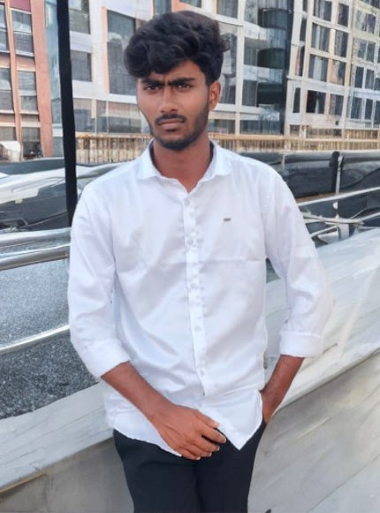
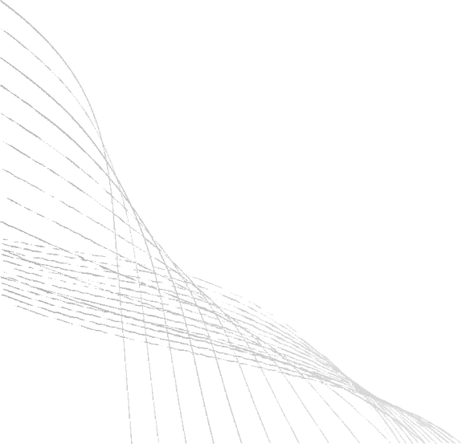
TITLE
DIGITAL PORTFOLIO
A JOURNEY THROUGH MY SOFTWARE PORTFOLIO
Welcome to my world of code and creativity, where ideas transform into impactful solutions
01

Slide 3

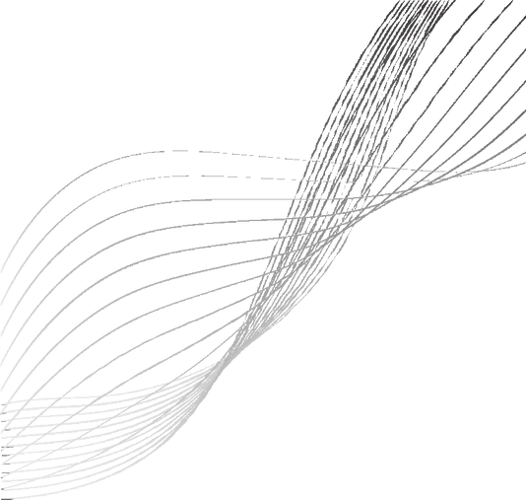
C O N T E N T S
Problem Statement
Project Overview
End Users
Tools and Technologies 5.Portfolio
design and Layout
Features and Functionality
Results and Screenshots
Conclusion
02
9.Github Link

Slide 4

R t O B h n m s Y A Y n m n m Y
There was a need for a personal portfolio website that showcases my education, technical skills, achievements, and contact information in a professional way.
The challenge was to design it responsive, modern, and interactive while being easy to maintain.
03

Slide 5
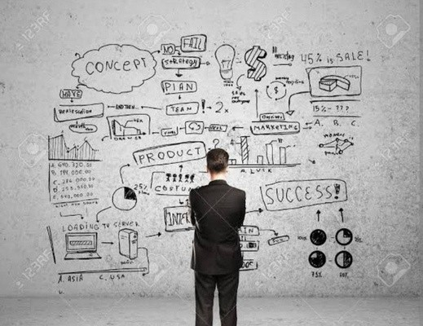
P R O JE C T O V E R V I E W
This project is a responsive portfolio website developed using HTML, CSS, and JavaScript.
It includes multiple sections: Home, Education, Skills, About Me, and Contact.
.
.
The design is enhanced with animations, dark/light themes, and interactive effects.
04

Slide 6


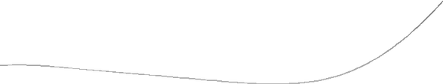
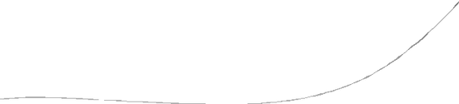

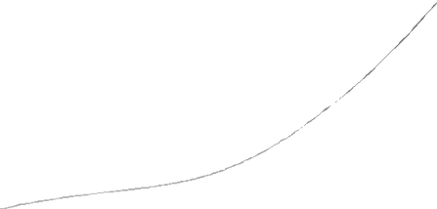
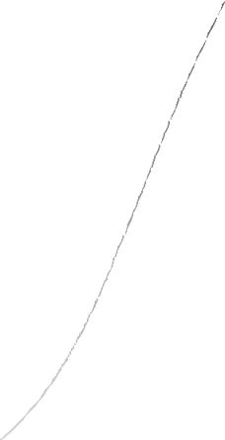


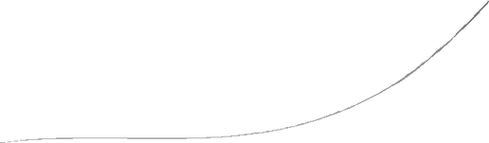




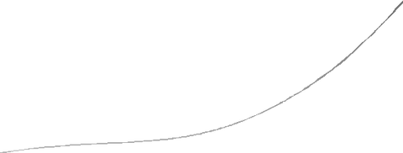

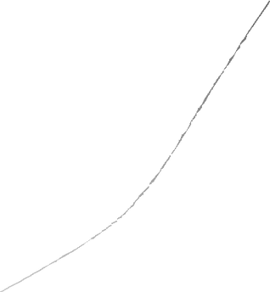
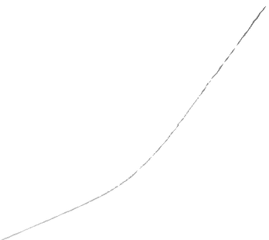
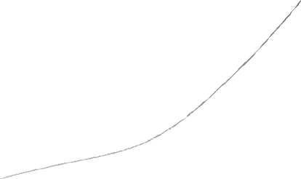
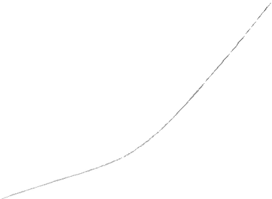





E N D U S E R S
Recruiters To evaluate my skills & projects
Academic faculty For showcasing achievements
Peers/Colleagues For collaboration and inspiration
Myself As a professional online presence
05

Slide 7

T O O L S A N D T E C H N O L O G Y ' S
HTML5 Structure
CSS3 Styling and Layout
JavaScript Interactivity
Font Awesome - Icons
Google Fonts Typography
6.Responsive Design Principles
06

Slide 8
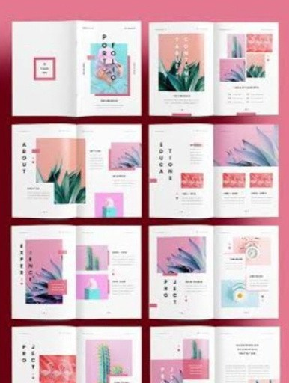
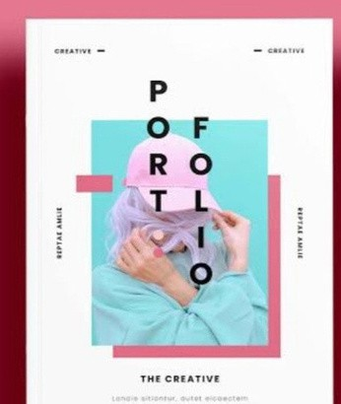
PO R T F O L IO D ESIN G AN D L O Y O U T
1.
Home Introduction with image & title
2.
Education Timeline format
3.
Skills Skill cards with hover animations
4. About Me Career objective, achievements,
hobbies
5.
Contact Form & contact details
6.
Footer Social media links
07

Slide 9
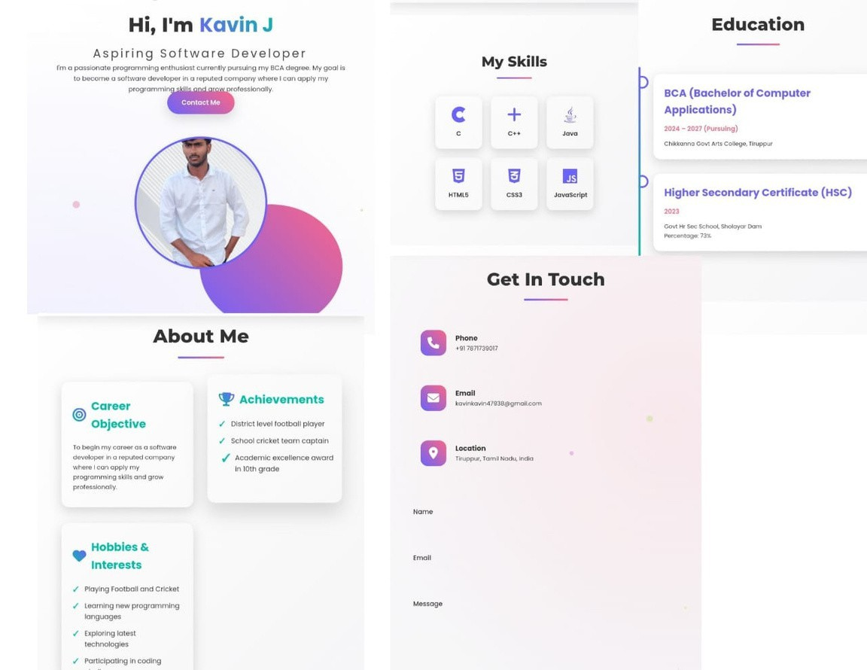
R E S U L T A N D
S C R E E N C H A T S
Screenchats of
Home Page
Education Timeline Skills Section Contact
Form
08

Slide 10

C O N C L U SIO N
Through this project. I have:
Improved my f ront- end development skills
Learned responsive and interactive web design
Built a professional portfolio for future career opportunities
08

Slide 11

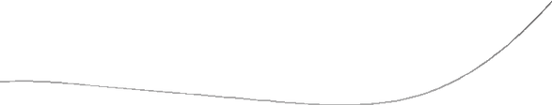
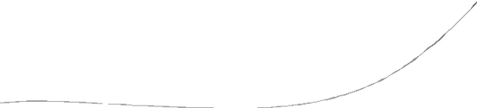

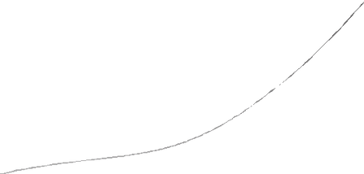
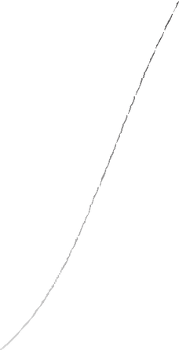


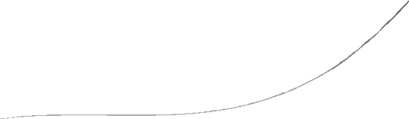




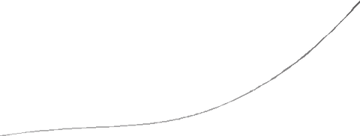

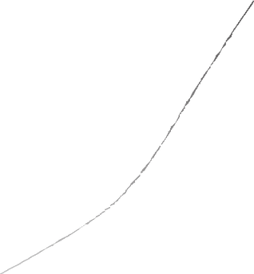
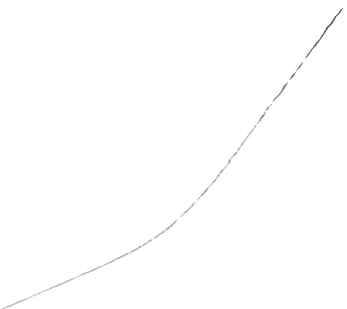
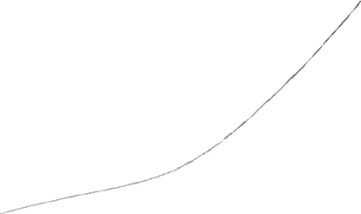
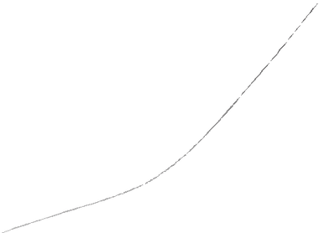





GITHUB LINK
GitHubRepository :(https://github.com/kavinkavin47938- lgtm/Kavin-J-TNSDC-FWWD-DP.git)
Email: kavinkavin47938@gmail.com
Phone: +91 7871739017
08

Slide 12
T H A N K
Y O U . . .
10

